Slide 1
Format Method
fname = "John"
age = 36
#empty placeholders: Default Order
txt1 = "My name is {}, I'm {}".format(fname,age)
#numbered indexes:
txt2 = "My name is {0}, I'm {1}".format(fname,age)
#named indexes:
txt3 = "My name is {f}, I'm {a}".format(f = fname,a = age)
The placeholders can be identified using
1 named indexes {a}, 2 numbered indexes {0}, 3 empty placeholders {}.
print(txt1)
print(txt2)
print(txt3)
My name is John, I'm 36
My name is John, I'm 36
My name is John, I'm 36

Slide 2
Input / Output Console Operations
Print Statement
Simple input and output
Output Formatting
#program to display the date
year = int(input(‘Enter the year’))
month = int(input(‘Enter the month’))
date = int(input(‘Enter the date’))
print(f'{date=:2d} - {month=:7s} - {year=:4d}')
print('{date} - {month} - {year}'.format(date=7,month='March',year=2023))
x = 10/3
print(f'{x:.4f}')

Slide 3
Control Flow Statements
Branching Statement – if, if-else, if-else-if, Nested if
Looping Statement – for, while
Unconditional Statement – break, continue

Slide 4
Branching Statements : if
Syntax:
if <expression>:
<Statements>
expr
Example:
a = 1
if a > 0:
print('a is positive number')
yes
True Stmt

Slide 5
Branching Statements : if-else
Syntax:
if <expression>:
<True_Statement>
else:
<False_Statement>
no
expr
Example:
a = 34
if a % 2 == 0:
print('a is even number')
else:
print('a is odd number')
yes
True Stmt
False Stmt

Slide 6
Branching Statements : if-else-if
Example:
a = 34
if a == 20:
print('a is equal to 20')
elif a > 20:
print(‘a is greater than 20’)
else:
print('a is lesser than 20')
no
no
no
no
expr1
expr2
expr3
exprN
yes
yes
yes
True Stmt
True Stmt
True Stmt
False Stmt

Slide 7
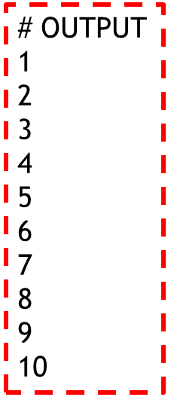
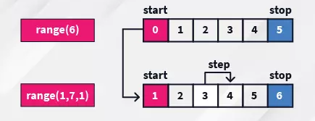
Looping Statement: for loop
Syntax:
for <variable> in range(<start_Value>,<end_value>,<stepping_value>):
<Statement>
Example:
for i in range(1,11):
print(i)
no
expr
Incr/Decr
yes
Statement

Slide 8
Looping Statement: for-each
P
y
t
h
o
n
P
r
o
g
r
a
m
m
i
n
g
Syntax:
for <variable> in <iterable>:
<Statement>
no
expr
Example:
Str1 = ‘Python Programming’
for st in str1:
print(st)
Incr/Decr
yes
Statement

Slide 9
Looping Statement: while loop
Syntax:
while <expression>:
<Statement>
Initialize
no
expr
Example:
i = 1
while i < 11:
print(i)
i = i + 1
Incr/Decr
yes
Statement

Slide 10
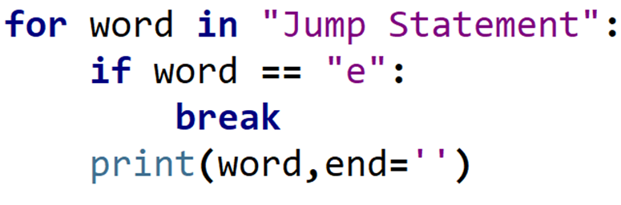
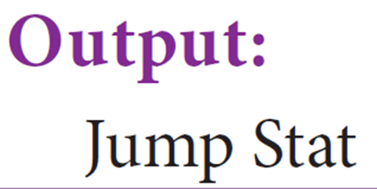
Unconditional Statements - break
no
expr
yes
break
expr
Incr/Decr
yes
no
Statement

Slide 11
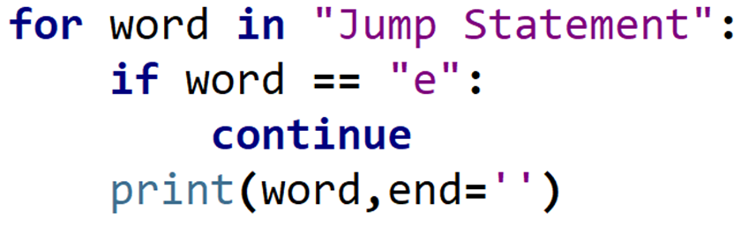
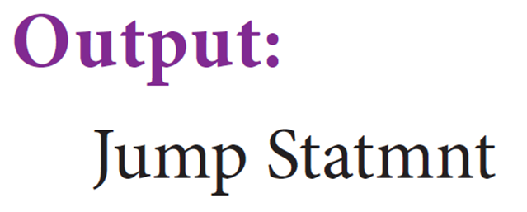
Unconditional Statements - continue
no
expr
yes
continue
expr
Incr/Decr
yes
no
Statement

Slide 12
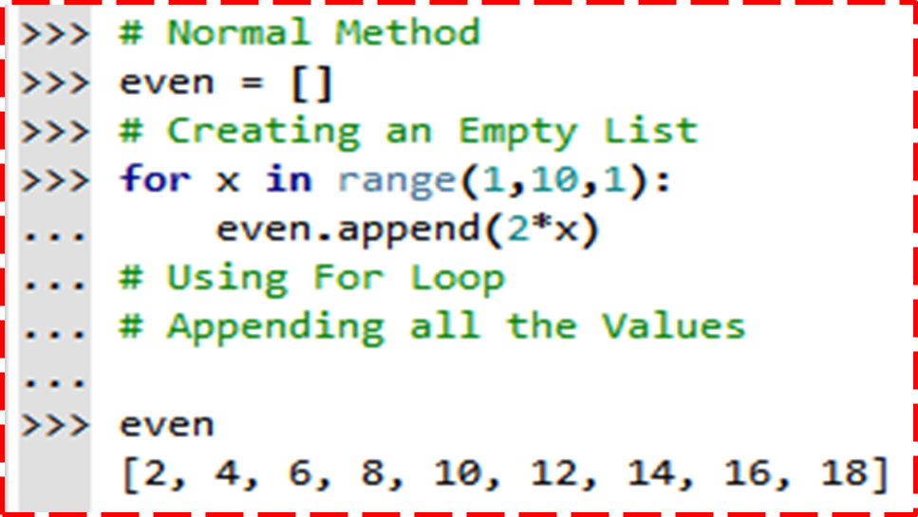
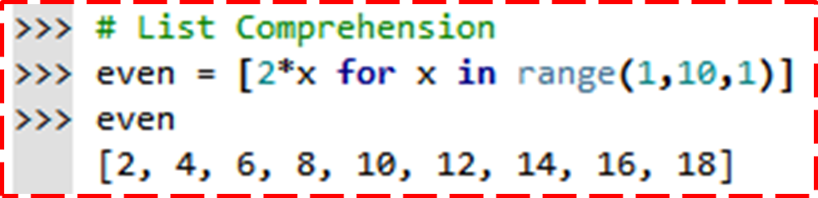
List Comprehensions
A list comprehension creates a new list by applying an expression to each element of an iterable
Syntax:
[<expression> for <element> in <iterable>]
Example:
squares = [x * x for x in (1, 2, 3, 4)]

Slide 13
Conditional List Comprehensions
list comprehension you can append one or more if conditions to filter values.
Syntax:
[<expression> for <element> in <iterable> if <conditions>]
Example:
[x for x in range(10) if x % 2 == 0]
Output: [0, 2, 4, 6, 8]

Slide 14
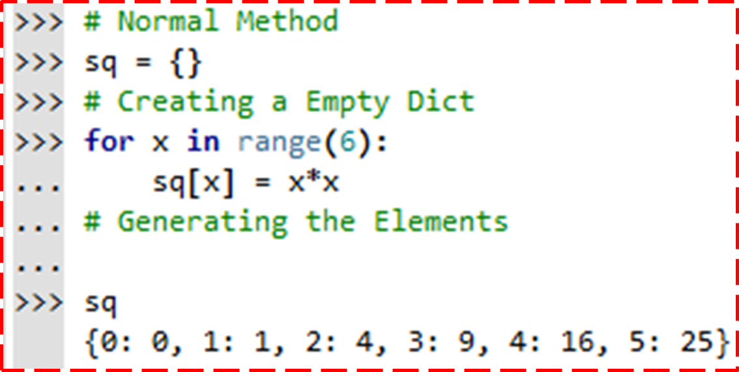
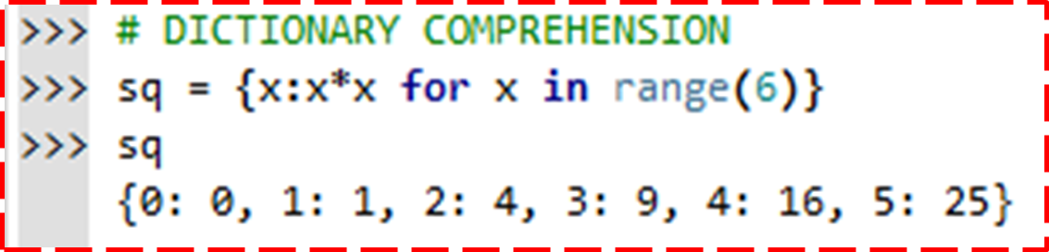
Dictionary Comprehensions
A dictionary comprehension is similar to a list comprehension except that it produces a dictionary object instead of a list.
Syntax:
{<expression> for <element> in <iterable> if <conditions>}
Example:
{x:x*2 for x in range(6)}
Output:
{0: 0, 1: 2, 2: 4, 3: 6, 4: 8, 5: 10}

